Slide 1

Visual Acuities, and Optimal Display
CAP 5738 Data Visualization
Spring 2018
Dr. Sayeed S. Alam

Slide 2
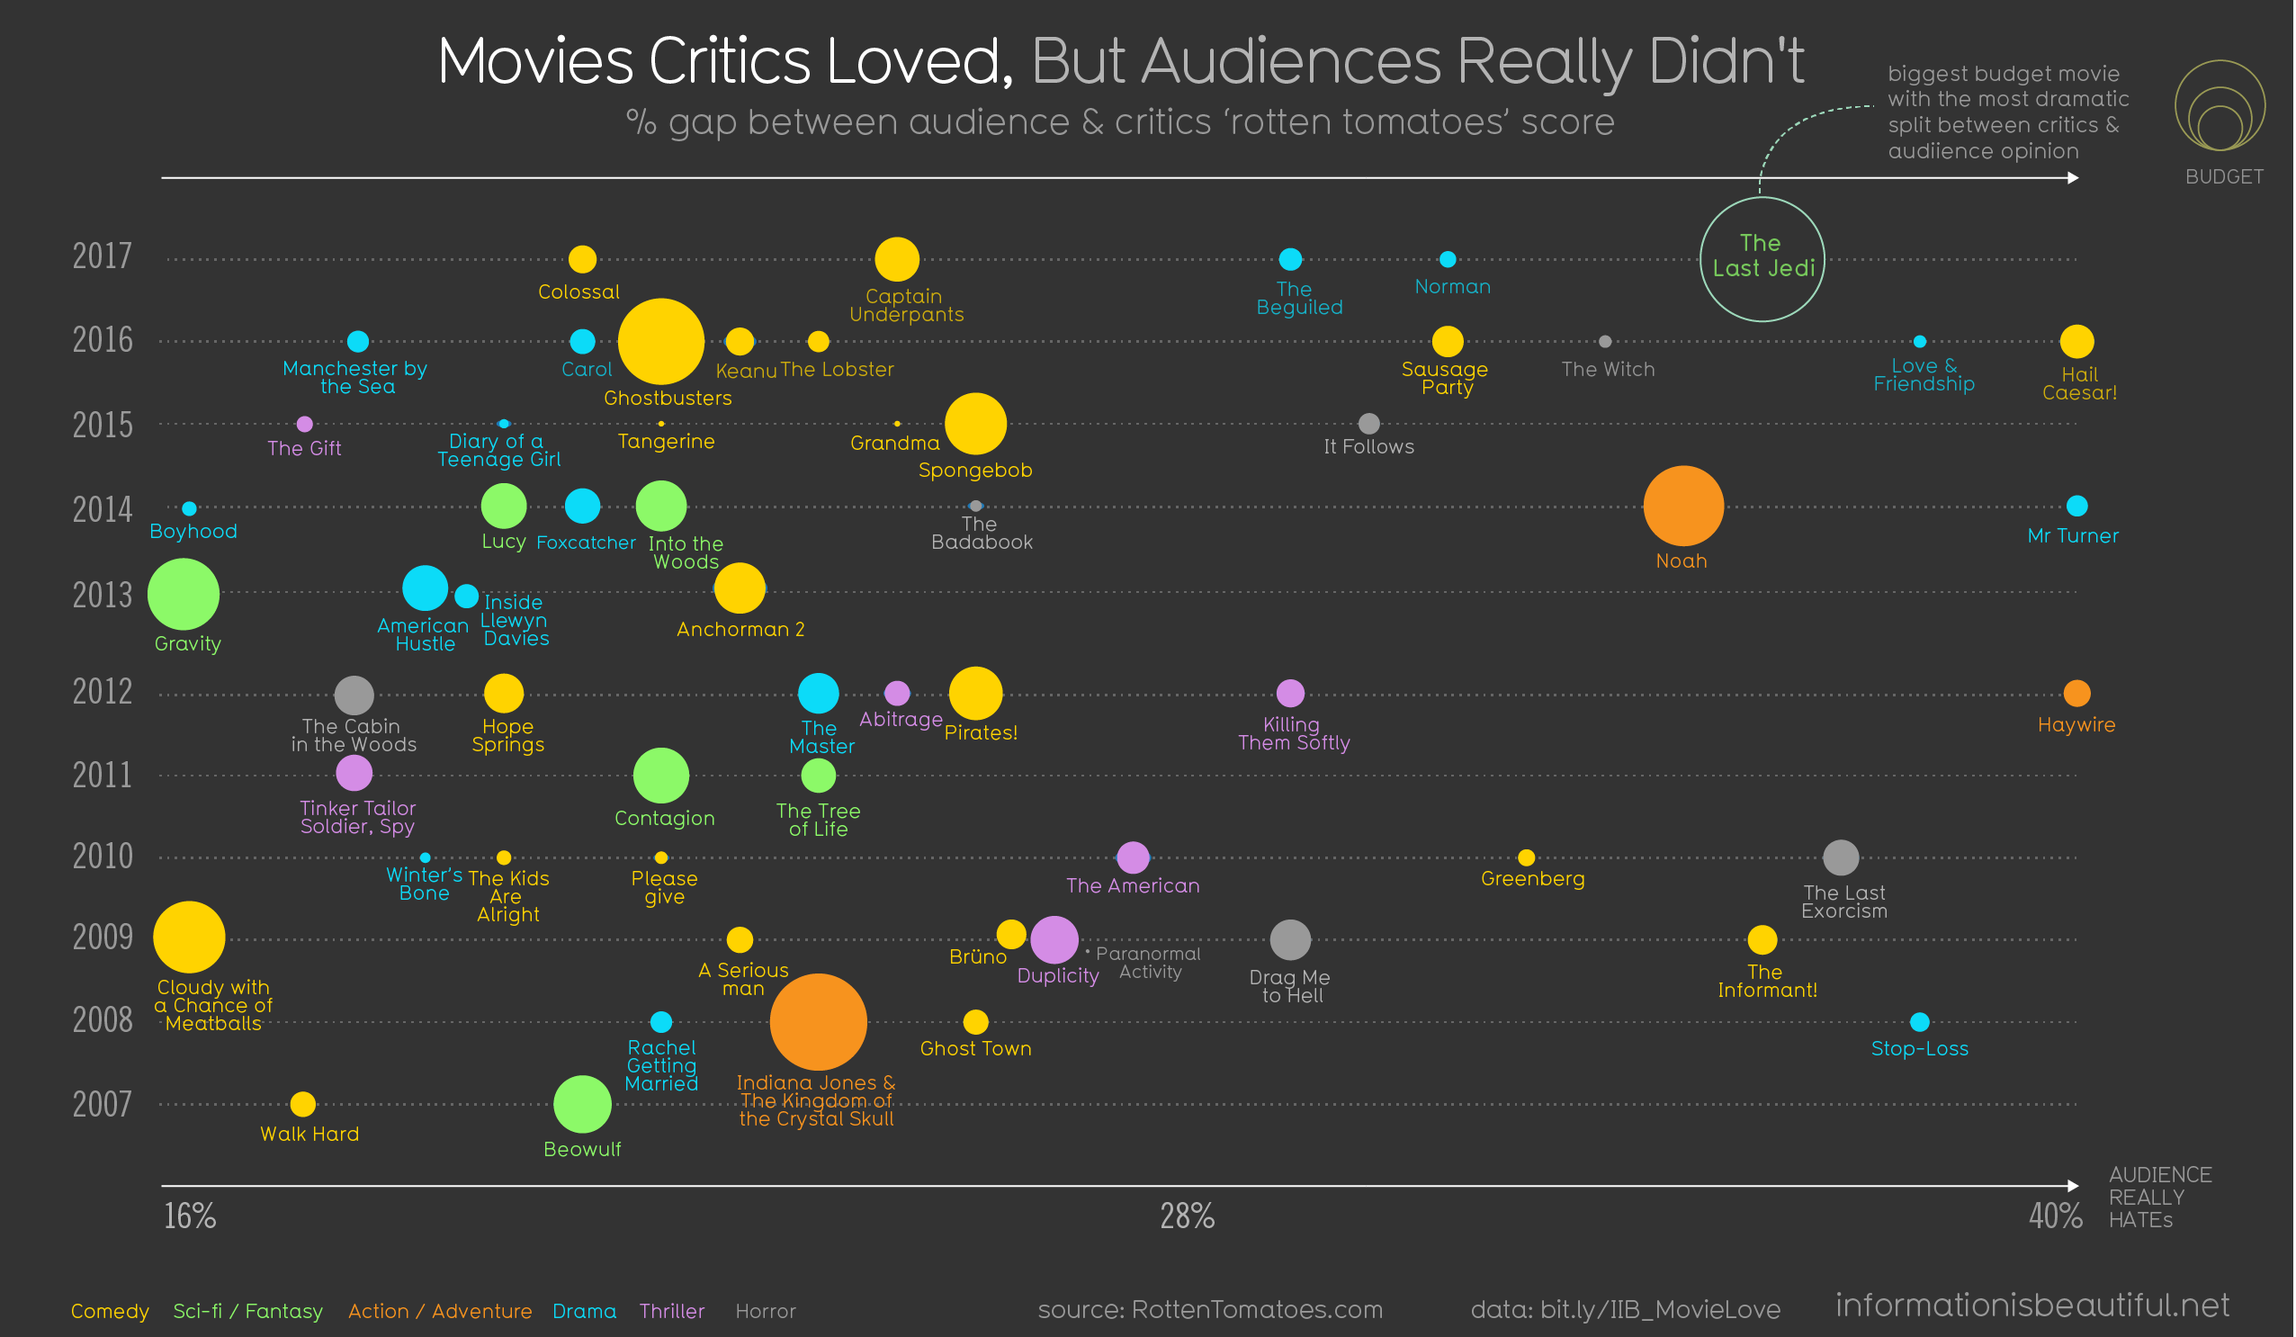
Today’s Visualization
Source: Informationisbeautiful.net

Slide 3
Paper Presentation
Paper presentation in a group of 2
Paper should be from renowned visualization/journals
Preferred conferences: InfoVis, EuroVis
Journals: TVCG, CGF
Please select your paper and group mate ASAP

Slide 4
Feedbacks
Send your positive/negative feedbacks (i.e. constructive criticisms).
To: salam011@cis.fiu.edu
Subject Line: [CAP5738-Spring2018-Feedback]
Let your Professor listen to you.

Slide 5

Visual Angle
$$\tan{(\frac{θ}{2})= \frac{h}{2d}}$$
$$θ=2\tan^{−1}{(\frac{h}{2d})}$$

Slide 6
Visual Acuities
Visual acuities are measurements of our ability to see detail.
Acuities are important in display technologies because they give us an idea of the ultimate limits on the information densities that we can perceive.

Slide 7
Basic Acuities
Basic Acuity | Visual Angle | Example
Point acuity: The ability to resolve two distinct points | 1’
Grating acuity: The ability to distinguish a pattern of bright and dark bars from a uniform gray patch | 1’-2’

Slide 8
Basic Acuities
Basic Acuity | Visual Angle | Example
Letter acuity: The ability to resolve letters. (Snellen eye-chart) | 5’ | E
Stereo acuity: The ability to resolve objects in depth | 10’
Vernier acuity: The ability to see if two line segments are collinear | 10’

Slide 9
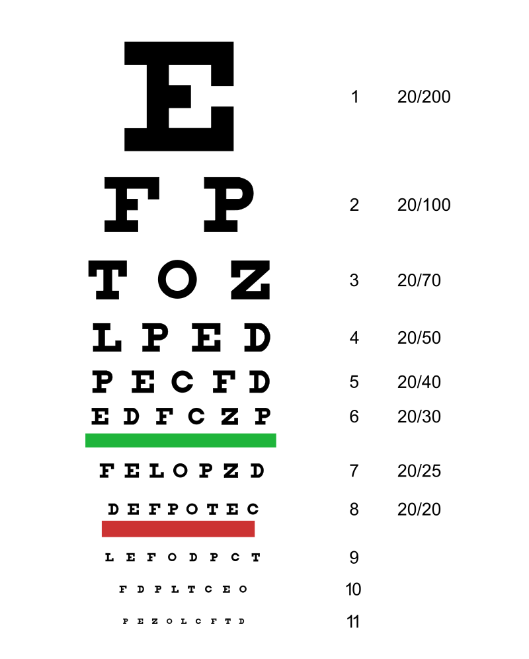
Eye test- Snellen Chart
Visual angle = θ = 5’
d= 6m
h = 2*d * tan(θ/2) = ?
What if anyone can see characters with ~87 mm height?
h = 87mm
d = h /(2* tan(θ/2)) = ?

Slide 10
Visibility vs Fovea distance

Slide 11
Brain Pixel
Ganglion cell
Rods and cones

Slide 12
Brain Pixels
At Fovea, 1 ganglion = 1 cone cell
At Peripheral, 1 ganglion = 1000 rod/cone cells

Slide 13
Brain Pixel and The Optimal Screen

Slide 14
Brain Pixel and The Optimal Screen
TPB = total number of brain pixels stimulated by a display
USBP = Uniquely stimulated brain pixels = TPB – redundant brain pixels
SP = Screen pixels
DE = Display Efficiency = USPB/ SP
VE = Visual Efficiency = USPB / TPB

Slide 15
Brain pixels vs Display Efficiency vs Visual Efficiency

Slide 16
Contrast Sensitivity
Sine-wave grating.
Spatial frequency : cycles/degree ( number of bars per degree of view angle)

Slide 17
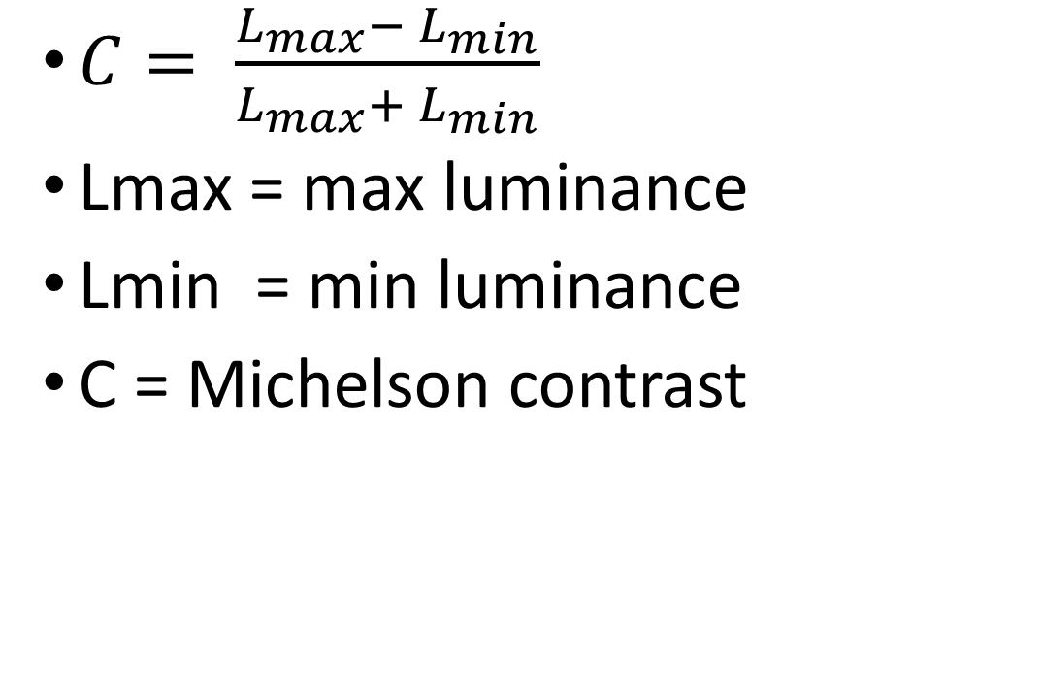
Michelson Contrast
$C= \frac{L_{max}− L_{min}}{L_{max}+ L_{min}}$
Lmax = max luminance
Lmin = min luminance
C = Michelson contrast
C = 0

Slide 18
Contrast Sensitivity Function
CSF = Contrast Sensitivity Function
MTF = Modulation Transfer Function
CSF = MTF(C)
Contrast Threshold = 1/CSF

Slide 19
Temporal Sensitivity

Slide 20
Visual Stress and Flickering
Pokemon panic of 1997
Japan 1997
Children sat closed to the TV and bright flashing scenes caused vomiting
Human flicker sensitivity limit = 50 hz
Spatial frequence = 3 cycles, flicker = 20hz will cause visual stress

Slide 21
The Optimal Display
Spatial grating : 50 cycles per degree
Antialiasing
Paper printer (Laser Printing)
DPI = dots per inch = ~ 1200
Refresh rate : 50-75 Hz

Slide 22
Thank You

